Slide 1


Major Project Presentation
Club Portal
Presented By:
Sanchita Mishra (1900290120097)
Sakshi Singh (1900290110084)
Shreyash Singh (1900290110106)

Slide 2
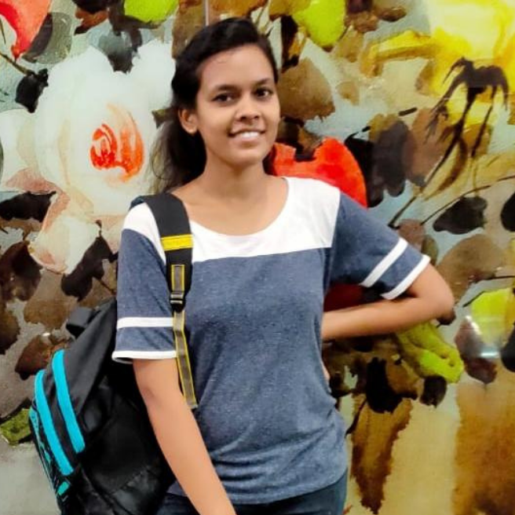
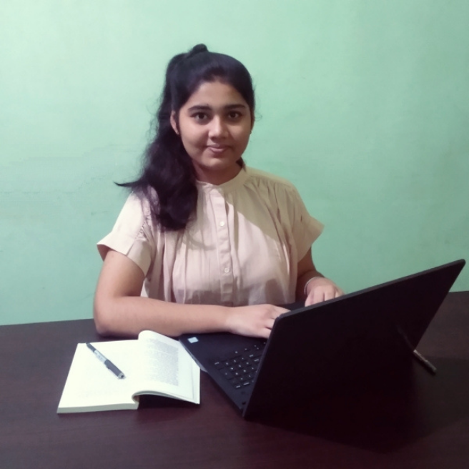
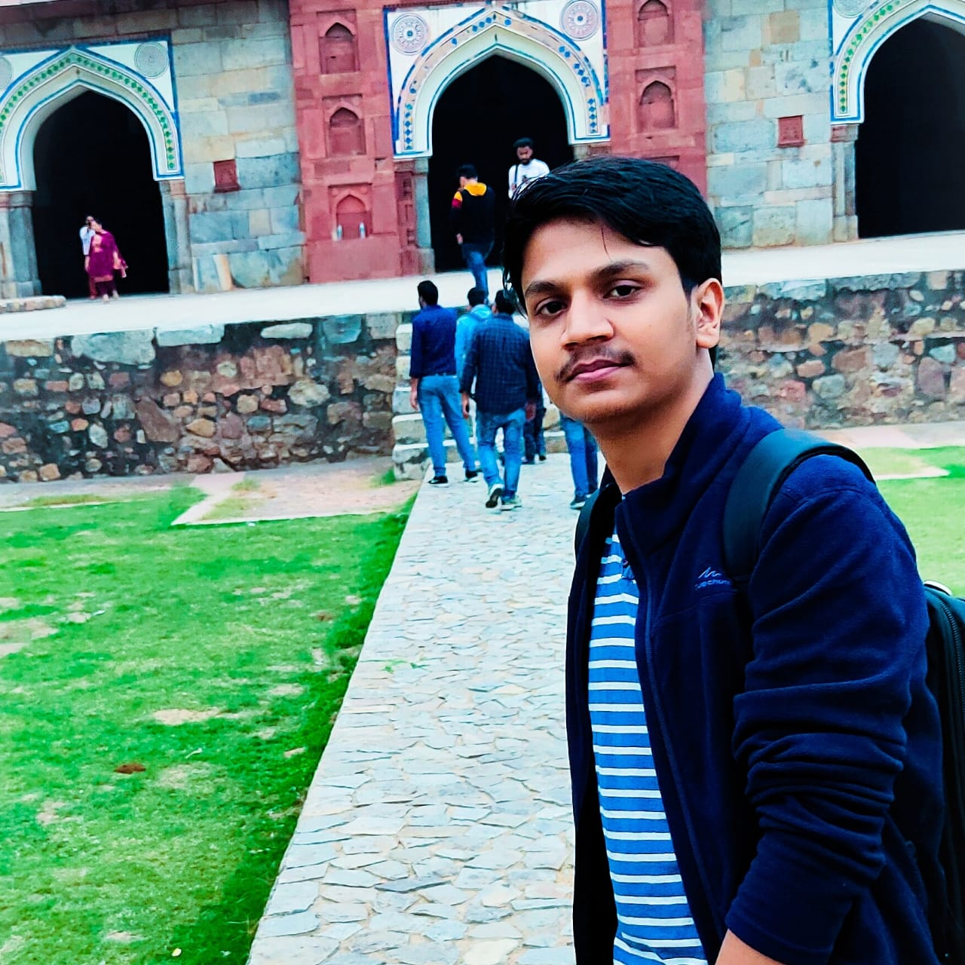
Team Details
Sakshi Singh– CSIT(B)
Uno: 1900290110084
Sanchita Mishra– CS(B)
Uno: 1900290120097
Shreyash Singh– CSIT(B)
Uno: 1900290110106

Slide 3
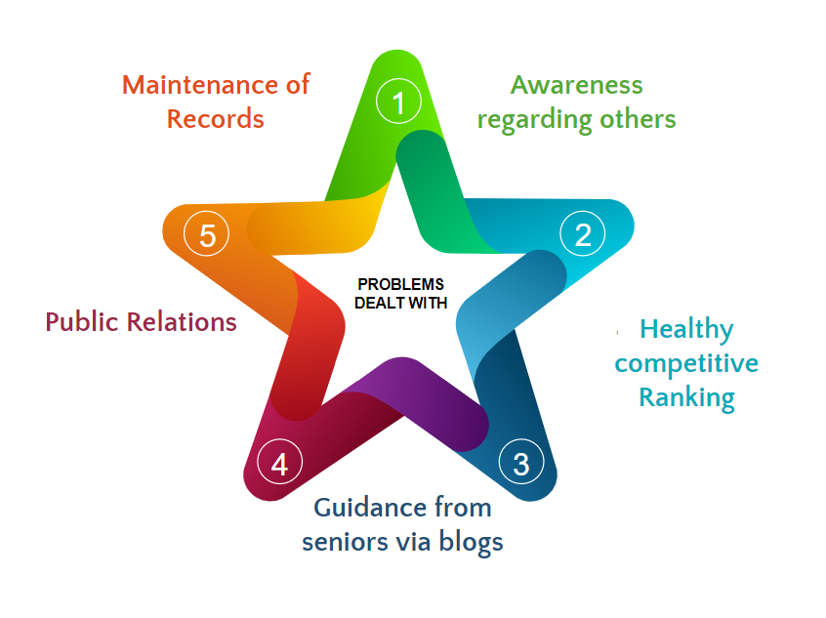
Problem Statement
Maintenance of the record of all the students- the projects, participation, victories, blogs etc.
Creating a healthy competitive environment, where students are aware of the achievements of everyone
Awareness and competition among the candidates.
Shortlisting for referrals by Alumni
Guidance for different companies via seniors
Presentation of candidate’s complete profile.
Showcasing the achievements and activities of a department/ Club.

Slide 4
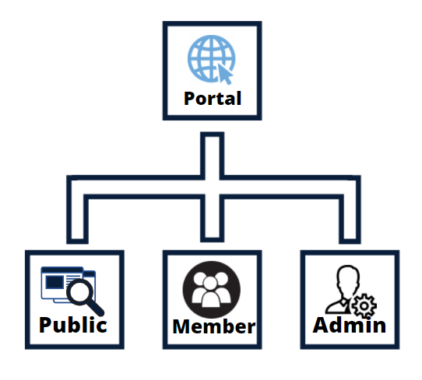
Solution: Web Portal
Major Divisions of the portal

Slide 5
Web Portal: Public View
This is available for everyone.
Features:
Introduction
Team
Achievements
Gallery
Contact Us
Updates
Testimonials
Developer Team
etc

Slide 6
Web Portal: Member View
It is available only to the members of the department.
Features:
Dynamic Profile Building
Ranking Model – based on various parameters
Writing and publishing Blogs
Keeping record of one’s achievements, projects, hackathons, blogs
Personalized resources according to their domain is provided to them.
Mentor and Mentees section to keep record and assign grades of tasks provided by mentors to the mentees.

Slide 7
Web Portal: Admin View
Accessible only to Developers and Admins.
Features:
Abstracted View: Division of accessibility according to role
Completely Dynamic
Action Performer Record: Record of all the backend activities is also maintained
Grant and Login of member credentials
Automatic Email Replies

Slide 8
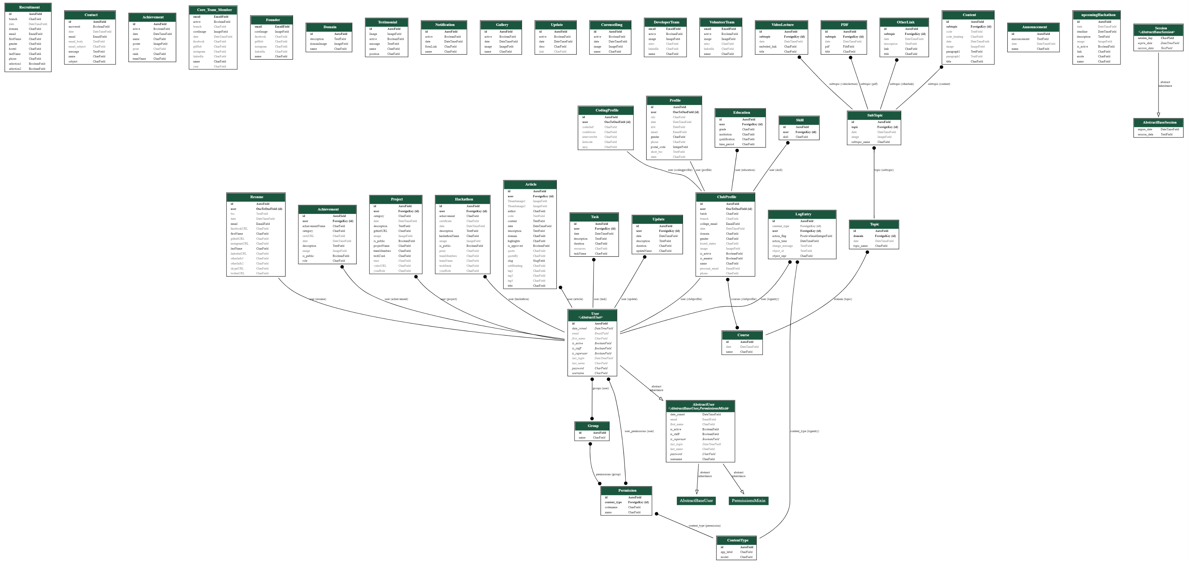
Database ER Model

Slide 9

Technologies Used
Frontend:
HTML
CSS
JS
Bootstrap
particle.js
Backend:
Django
Python
Databse:
Local- Sqlite3
Server- SQL
Scrapper:
Selenium
Beautiful Soup
Hosting:
AWS- EC2 instance
Static Storage:
AWS- S3
Python S3 boto
Algorithm:
Classifier Algorithm (yet to be decided)
Version Controllers
Git & Github

Slide 10
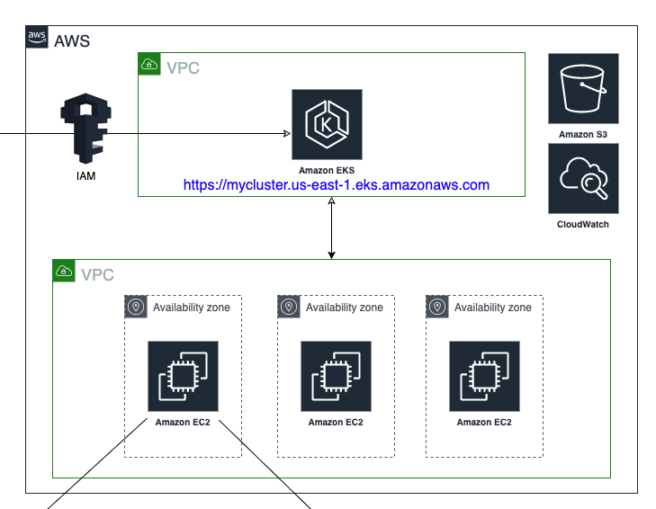
Scalability
The portal was being used for registration and recruitment of students of the college, where entries of 750+ students were managed automatically without any failure.
The clickthrough rate (CTR) reached to an approximate of 500 per second due to which we faced a server failure, so we had to make it more scalable to avoid server overloading.
So we used load balancer from AWS which creates replicas of server that are capable of handling more requests without much increase in cost.

Slide 11
Security
Cross-Site Request Forgery (CSRF) : It forces authenticated user to submit a request to a web application against which they are currently authenticated. Such attacks exploit the trust an application has in its users.
To avoid such type of attacks we have made use of CSRF Middleware, where we have added CSRF tokens for every POST request send to the server.
Use of ORM: We have made use of Object Relational Mapper in Django instead of directly connecting database to the frontend. ORM layer also acts as a security layer to send data between the database and models in an application.

Slide 12
Project Outcome
Research Paper: Classifier Algorithm for Student Ranking (currently working)
Field: Machine Learning
We’re working upon development of our own algorithm which will be used to classify and rank students according to our parameters. The algorithm is specific for students with technical interest.
Research Paper: Security Issues with Django and its handling (yet to start with)
Field: Cyber Security
Even though Django provides its own security mechanism, our site was being hijacked and no. of fake emails were sent through our official id to unknown accounts.
We handled it but are yet to explore regarding the security breach and its functioning.

Slide 13



Candidate Classifier
A single pager Resume is not enough to judge a candidate. However we can classify the candidates on the basis of information collected in the portal.
Cronjob
web scrapping Classifier Algorithm
(n – parameters)
Candidate Profile Collected Data Ranking

Slide 14
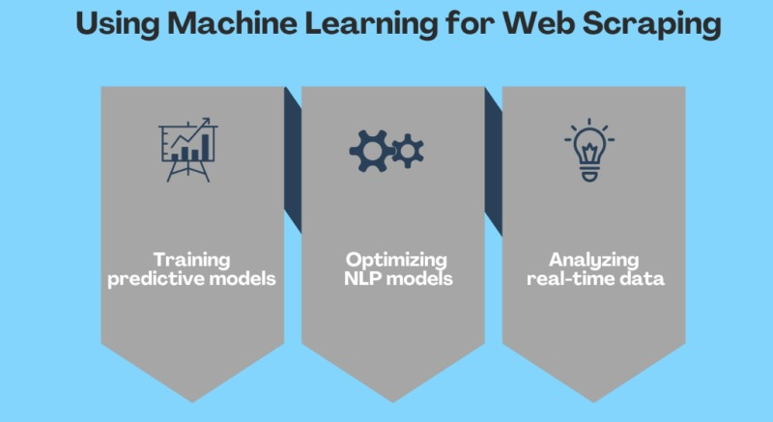
Candidate Classifier
Step 1: Data Collection (via different sections in the portal)
Step 2: Data Mining: Using selenium and beautiful Soup
Step 3: Ranking Algorithm
Step 4: Ranking Result (frontend)

Slide 15


Proposed Timeline
Semester-5 (Public View)
Semester-6 (Member View + Research on classifier algorithm)
Semester-7 (Implementation of Classifier Algorithm)
Semester-8 (Admin View Organization + Code Cleaning+ Documentation + Launch Open Source)
Checkout innogeeks.in

